Slide 1

News Sentiment Analysis for Stock Data
Group 32 - Felix Chung, Changyu Wu, Hanyu Zhang

Slide 2
Introduction
Investors are irrational
News
Perform sentiment analysis on news headlines to predict stock price changes
Notes:
The majority of investors are ordinary people who trade based on their instinct without conducting full financial analysis of the company.
News article headlines become one of the most important factors that can heavily influence investors’ behaviors which will fluctuate stock prices.
Our project will try to predict stock trends based on news headlines using several classification methods.

Slide 3
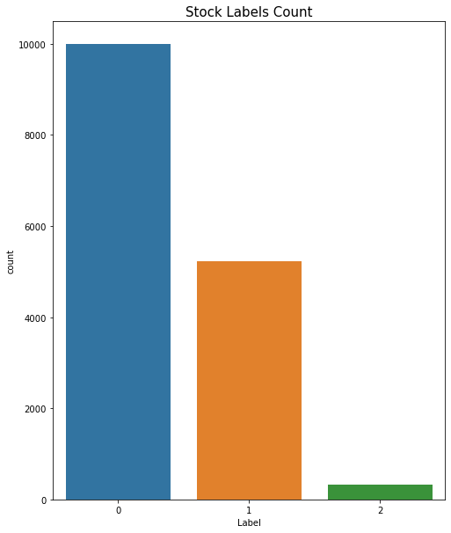
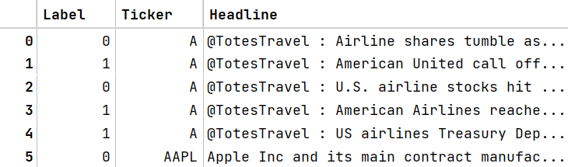
Quick Visualization
Three classes of sentiment labels:
0 - stock price decrease
1 - stock price increase
2 - no change on price
Notes:
The dataset we use contains the news headline, the stock ticker, and the label that indicates the stock trend after publishing the news headline
* 0 -> The stock went down by market close the day the article was published (negative) * 1 -> The stock went up by market close the day the article was published (positive) * 2 -> The stock stayed the same by market close the day the article was published (neutral)

Slide 4
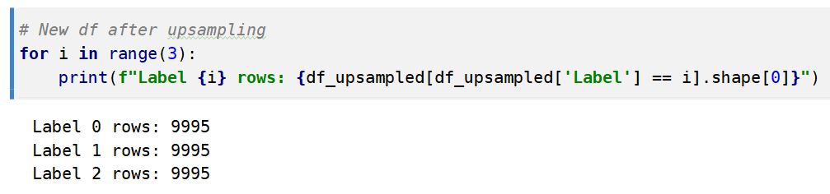
Upsampling
Label 1 and 2 are far less than label 0
To improve accuracy of our Naive Bayes and SVM, we may need to do upsampling.
Notes:
Because LSTM is insensitive to imbalanced data, this step is not necessary.
And in the following experiment, we found that upsampling doesn’t affect the accuracy of LSTM.

Slide 5
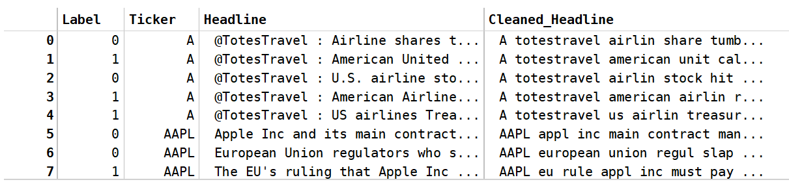
Preprocess Headlines
Remove links, punctuations, stopwords
Lowercase headlines
Perform stemming operation so that similar words are reduced
In order to consider stock name as a part of data set, we add all the stock names into the head of Cleaned_Headline
Notes:
Before prediction, we need to clean our data set.

Slide 6
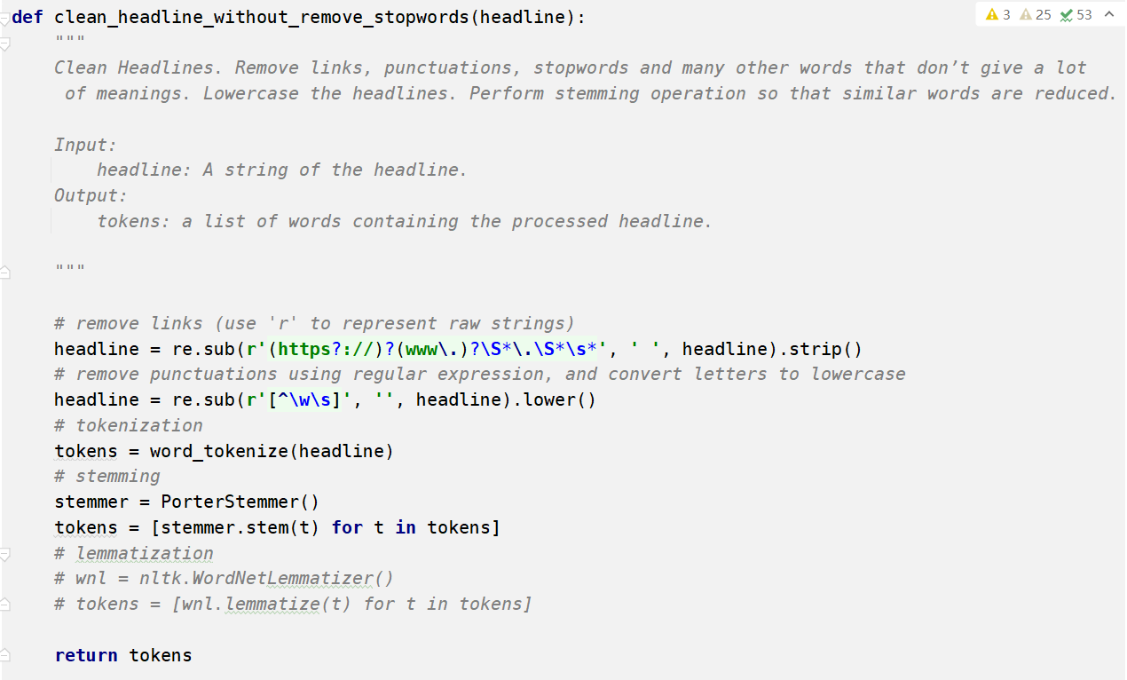
Code Demo – Preprocessing

Slide 7
Models
We used the following models to predict the change in stock prices:
Naïve Bayes – Construct the model by ourselves
SVM – Use sklearn
LSTM – Construct the model with torch
Notes:
Here, we are going to introduce our models. We have three models in our project to predict the change of stock price.
We regard Naïve Bayes as the baseline of our project model design.
We will introduce Naïve Bayes first.

Slide 8
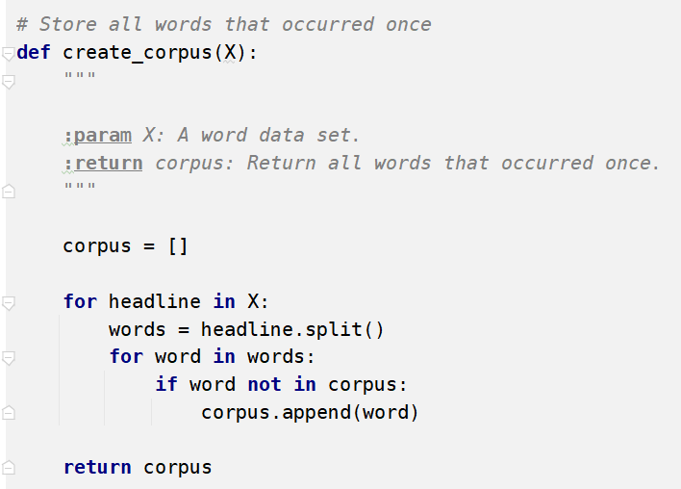
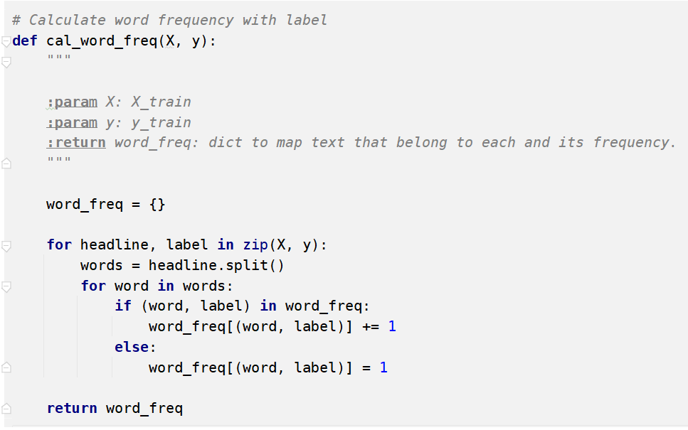

Naïve Bayes
Classification based on probability
Count occurrence of each word given different classes
Calculate the probability of a those word will appear in given class
Select the class with highest probability
Notes:
To calculate the baseline accuracy, we classify each row of data with conditional probability.
We trained the data by counting the number of words in each class
Then calculate the probability of each word that will appear in those classes.
In the end, when we see a news headline, we will look at the probability of all the words given its class,
that made up the headline,
then select the class with the highest probability to be our prediction.

Slide 9
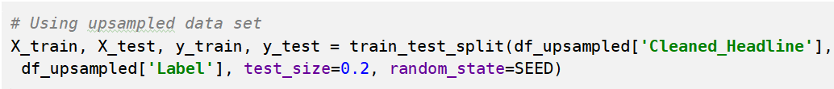
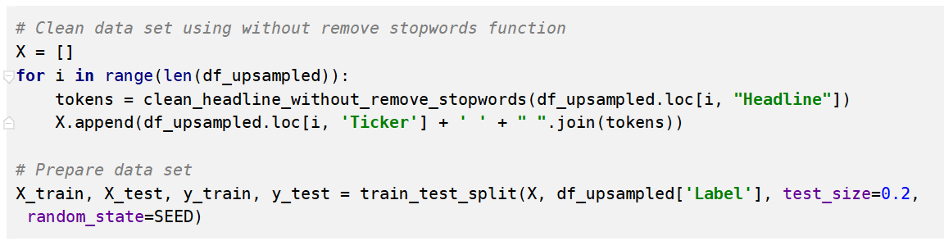
Data Preparation
Using train_test_split function in sklearn library to split the original data set into Training and testing data set.
Clean data with removing stopwords
Clean data without removing stopwords
Notes:
In NB, we used two different data sets to train the model. One contains stopwords, the other one we remove stopwords.

Slide 10
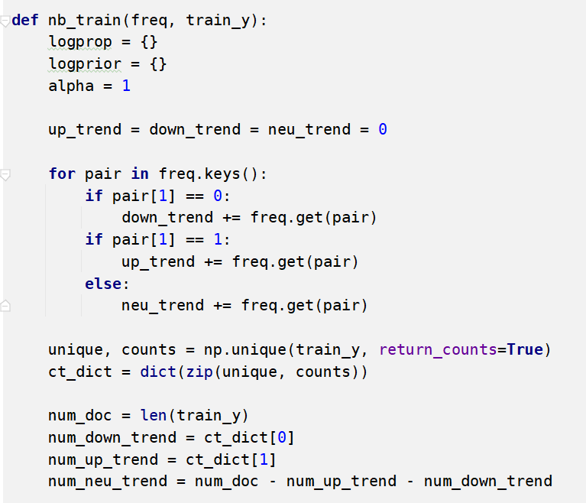
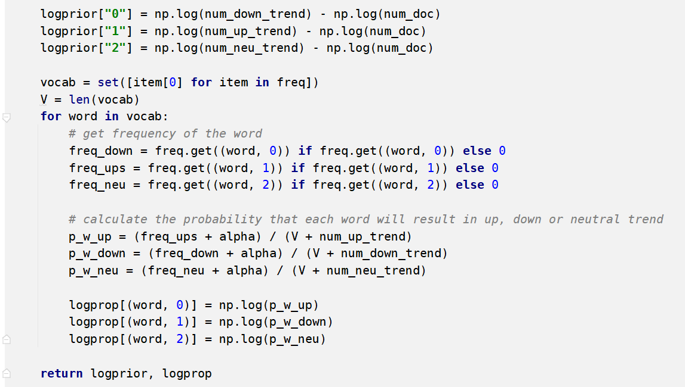
Code Demo – Training Function

Slide 11
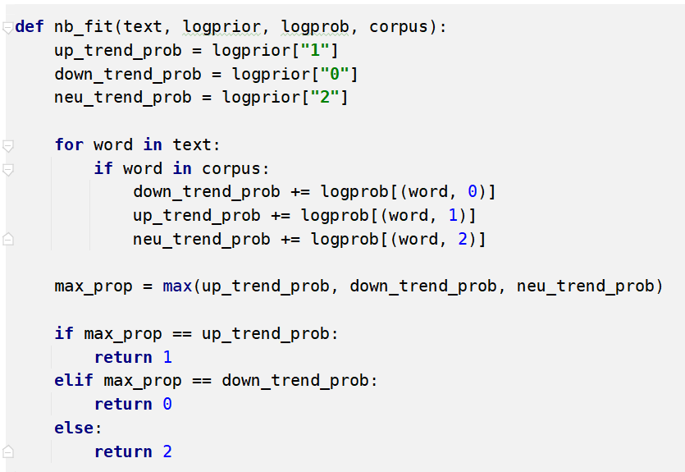
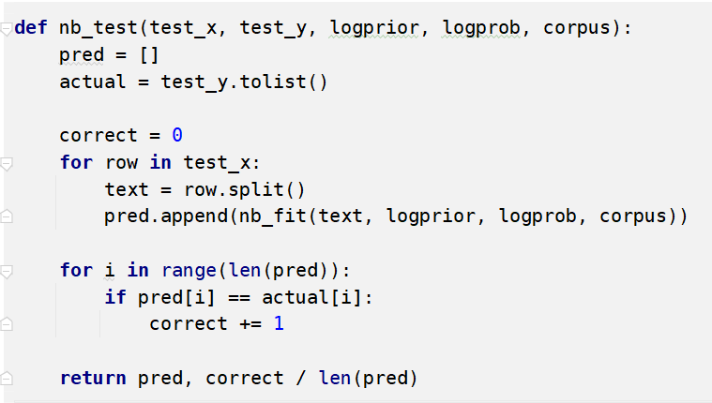
Code Demo – Testing Function

Slide 12
Results
We used two different training data to train our NB model.
One with stopwords, another without stopwords.
Without stopwords:
Accuracy: 48.37 %
Weighted F1-Score: 0.4737
F1-Score by label class:
Label 0: 0.2806
Label 1: 0.1901
Label 2: 0.9621
With stopwords:
Accuracy: 48.02 %
Weighted F1-Score: 0.4701
F1-Score by label class:
Label 0: 0.2542
Label 1: 0.2092
Label 2: 0.9582
Notes:
There isn’t big difference with using stopwords

Slide 13
Support Vector Machine (SVM)
Using sklearn svm package
Construct hyperplanes in multidimensional space to separate different classes
Find the hyperplane with maximum margin from nearest data points
Support Vectors
Data points closest to the hyperplane
Used in the decision function
SVM Kernels
Functions that transforms input data space into required form
Converts non separable problem to separable problems by adding more dimension to it
Linear, polynomial, radial basis function
Notes:
Separates
Here an important component is the svm kernels.
In our SVM model, we use two kernels, linear and rbf.

Slide 14
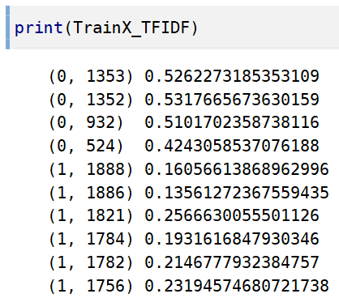
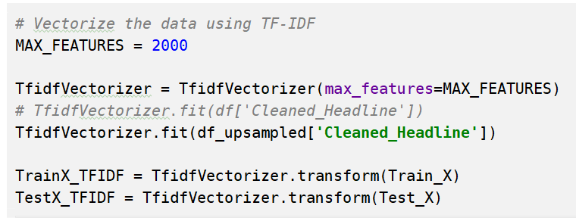
Convert word to vector (TF-IDF)
Split the original data set into training and testing parts by sklearn
Word vectorization with TF-IDF

Slide 15
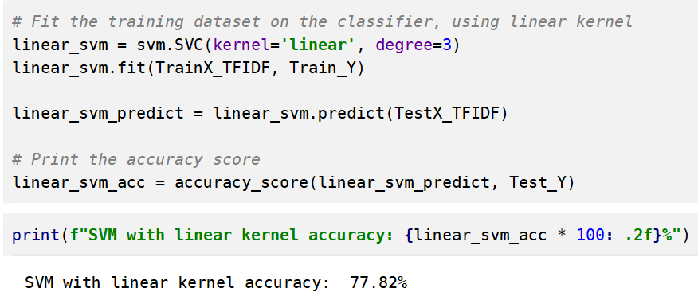
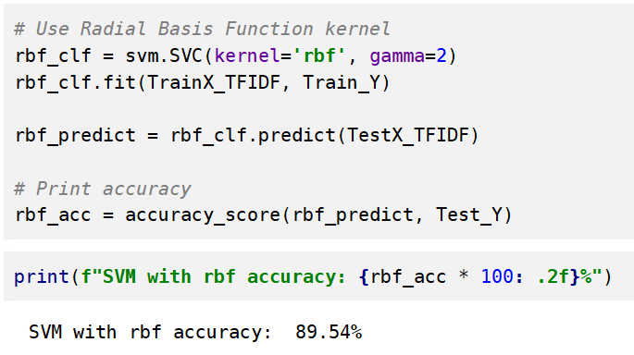
Code Demo – SVM Model

Slide 16
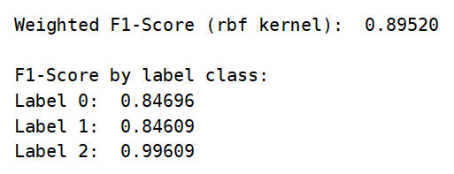
Evaluation
Accuracy without upsampling:
Linear kernel: 65.67 %
RBF kernel: 72.65 %
Accuracy with upsampling:
Linear kernel: 77.82 %
RBF kernel: 89.54 %
By examining the F1-score across classes:
This model for label 2 prediction may be overfitted

Slide 17
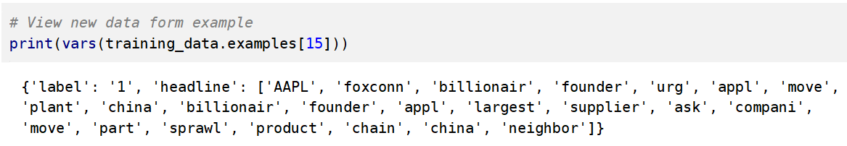
LSTM
We used torch to build the Bi-Directional LSTM Neural Network
First, transfer data into torch form with torchtext.legacy.data
Notes:
Here we are going to introduce our LSTM model.
After this transformation, we could use data in pytorch. Here is an example data after transforming.

Slide 18
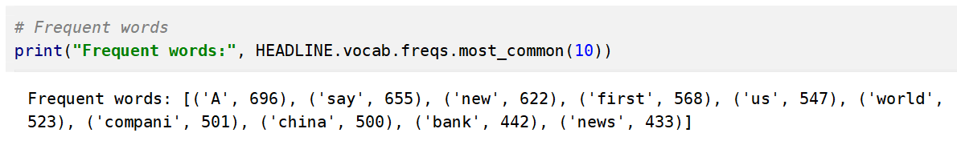
Convert words to vectors (GloVe)
Split data set
Convert words to vectors with GloVe
Notes:
Before training neural network, we convert words to vectors with GloVe. Indeed, we did convert words to vectors with TF-IDF in SVM before. Why not TF-IDF here? We have a brief test that shows there is a little bit improvement in accuracy when we use GloVe. So we use GloVe as the vectorizer.

Slide 19
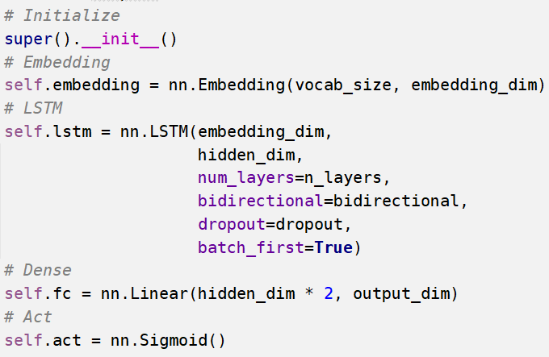
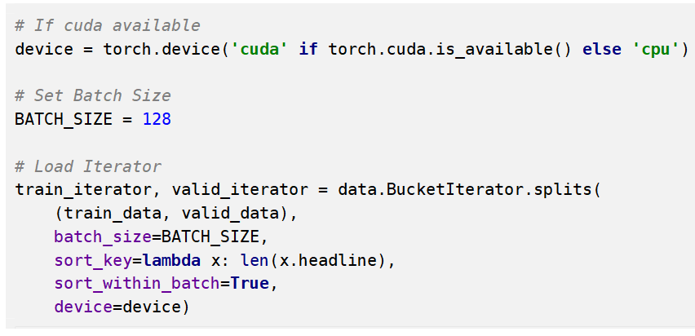
Build the Neural Network
We build the Bi-LSTM Neural Network, set hyper-parameters, and optimizer
(Here are part of the network’s codes)
Notes:
We build the bi-directional LSTM neural network here. And here the screenshots are main codes.

Slide 20
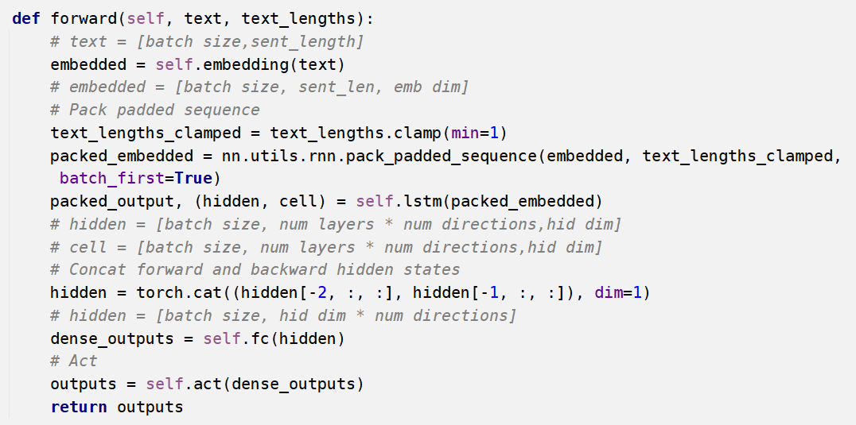
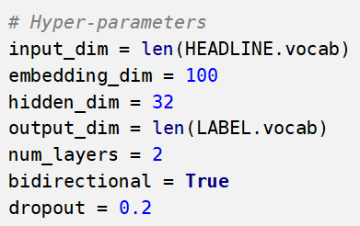
Code Domo
Notes:
We set hyper-parameters here. The embedding dimension is 100. The hidden dimension is 32. The input dimension is the length of HEADLINE, which is 64. And the output dimension is the length of LABEL, which is 3.

Slide 21
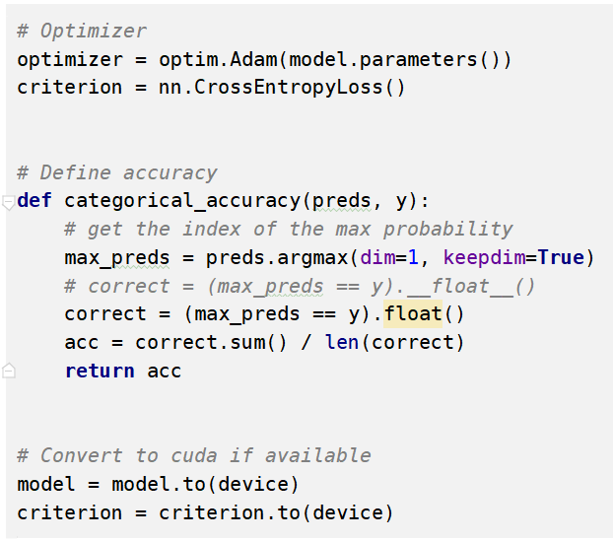
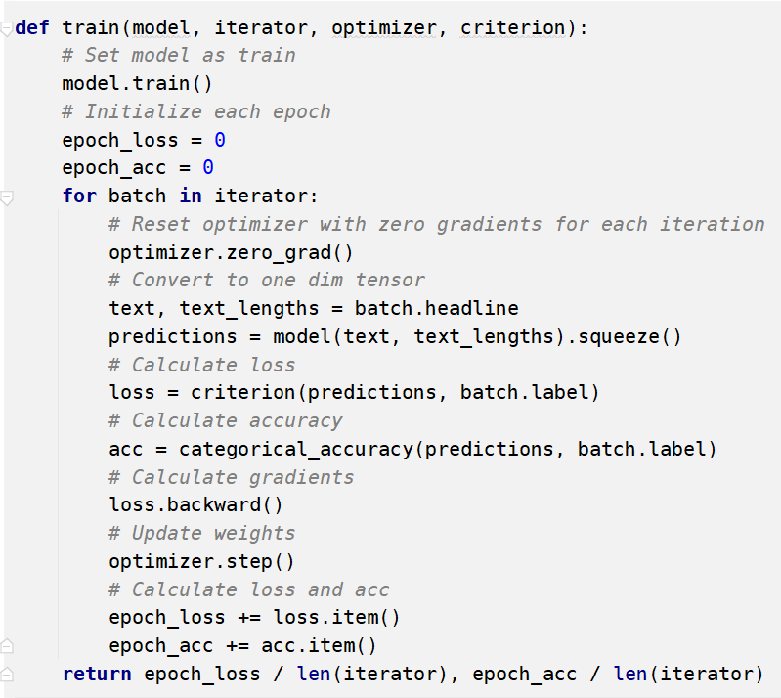
Optimizer
We use Adam as the optimizer
Cross Entropy Loss as the Loss criterion
Notes:
We set the optimizer as Adam, and the loss criterion as cross entropy loss. Actually, there is nothing big difference when we use different optimizers in this project.
Then we write a function to calculate accuracy. It is shown in the middle of the left screenshot. Variable max_preds is used to convert the 3 dimensional tensor into 1 dimension, so we could reach the prediction, category 0, 1, or 2.

Slide 22
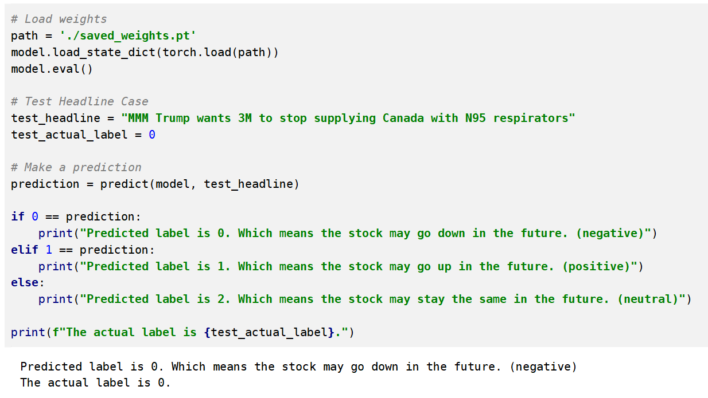
Test Case
Load LSTM weights
MMM --- 3M Company
Actual Label 0 --- Real Stock Price Change (went down)
Predicted Label --- 0
Notes:
We write a function to implement test case. First, as the pink box shows, we load LSTM wights, which the training results. Then, we make a prediction of a headline. In this case, MMM in the orange box represents the stock name of company, which is 3M company. The test headline is “Trump wants 3M to stop supplying Canada with N95 respirators”. The Real stock price went down after this news being published. And our model gives the right prediction.

Slide 23
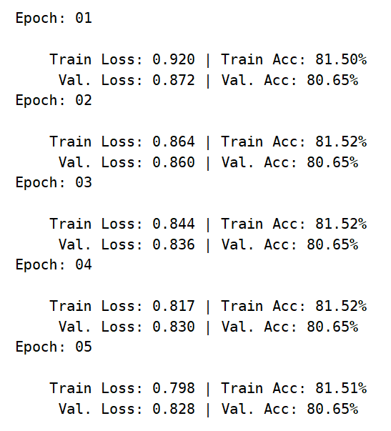
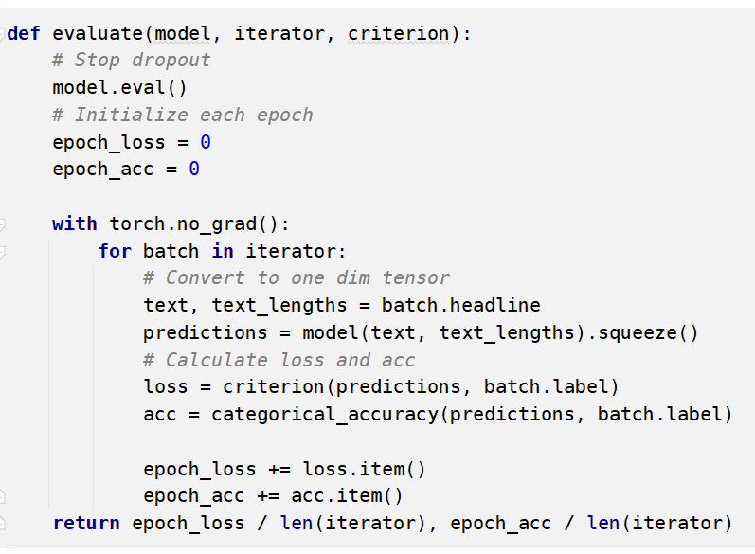
Evaluation
We use accuracy as the evaluation indicator
Notes:
But the model does not always provide us right predictions. We write a function and use accuracy as the evaluation indicator, and after test, the accuracy in our LSTM model is about 80 percent.

Slide 24
Conclusion
Naïve Bayes (Baseline): 48 %
SVM RBF kernel: 90 %
LSTM: 80 %
Notes:
To compare these three models. As we can see, our model improve the baseline accuracy a lot. But surprisingly, SVM get the highest accuracy. We concludes that LSTM is not well trained, maybe we did not provide good hyper-parameters. Maybe our model is not complicated enough to train the data well. Or maybe we need more data too train this model.

Slide 25
Future Work
Build a more complicated Neural Network model, maybe in LSTM, for a better prediction
Ensemble model – Add other parameters
trading volume
opening price
closing price
Cross Validation as a supplement of evaluation
Notes:
So, in the future, we could improve our LSTM model, build a more complicated one.
We could collect more data, even add other parameters that may influence the stock price variation, such as trading volume.
Besides, we can do cross validation to learn better about our models.

Slide 26
References
https://medium.com/@bedigunjit/simple-guide-to-text-classification-nlp-using-svm-and-naive-bayes-with-python-421db3a72d34
https://discourse.qingxzd.com/t/pytorch/58
Notes:
Here is our references.

Slide 27
Thank you!
Notes:
Thanks for your listening.

